Slide 1
Web Scraping Python for Econometrics

Slide 2
Technical Definitions Deconstruction v Construction

Slide 3
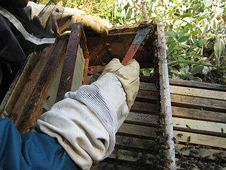
Definitions
Scraping Using tools to gather data you can see on a webpage A wide range of web scraping techniques and tools exist. These can be as simple as copy/paste and increase in complexity to automation tools, HTML parsing, APIs and programming
Scraping propolis from the sides of the bee box
Image by Abalg~commonswiki

Slide 4
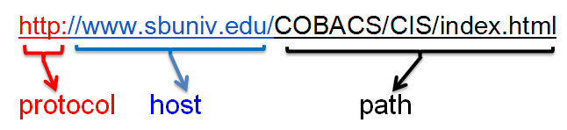

Definitions
Scraping
HTTP HyperText Transfer Protocol Machine interchange information transported over the Internet to enable multi-media data exchange, aka WWW. The protocol defines aspects of authentication, requests, status codes, persistent connections, client/server request/response. etc. Access a server on port 80; the declarative Document Type Definition ( HTML, XML, JSON, etc.)
Images from commons.WikiMedia.org

Slide 5
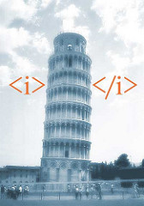
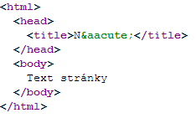
Definitions
Scraping
HTTP
HTML HyperText Markup Language The standard markup language on the Web As the web evolves so does the proliferation of technical wrappers surrounding the visible content of websites (text and data)
Image by Jesper Rønn-Jensen
Image by Michaelbrabec

Slide 6
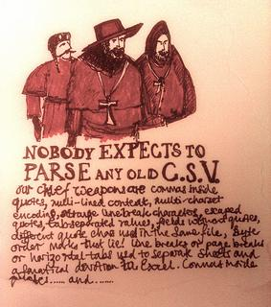
Definitions
Scraping
HTTP
HTML
Parsing The act of analyzing the strings and symbols to reveal only the data you need
Image by Paul Downey

Slide 7

Definitions
Scraping
HTTP
HTML
Parsing
Crawling Moving across or through a website in an attempt to gather data from more than one URL or page
Image by Dave Gingrich

Slide 8
Definitions
{ "firstName": "John", "lastName": "Smith", "isAlive": true, "age": 25, "address": { "streetAddress": "21 2nd Street", "city": "New York", "state": "NY", "postalCode": "10021-3100" }, "phoneNumbers": [ { "type": "home", "number": "212 555-1234" }, { "type": "office", "number": "646 555-4567" } ], "children": [], "spouse": null }
Scraping
HTTP
HTML
Parsing
Crawling
JSON Javascript Open Notation Readable text used to transmit data objects consisting of attribute-value pairs -- Wikipedia

Slide 9
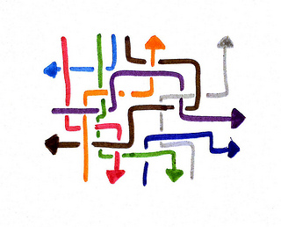
Definitions
Scraping
HTTP
HTML
Parsing
JSON
Crawling
API Application Programming Interface
A set of rules and protocols used to build a software application. In the context of Web Scraping an API is a method used to gather clean data from a website (i.e. data that is not wrapped in HTML, Javascript, bound in HTTP, etc.)
Image by Tsahi Levent-Levi

Slide 10
Web Scraping Legality
The type of data you are scraping
How you plan to use the scraped data
How you extracted the data from the website
The type of data you are scraping
How you plan to use the scraped data
How you extracted the data from the website
Am I scraping personal data?
Am I scraping copyrighted data?
Am I scraping data from behind a login?

Slide 11
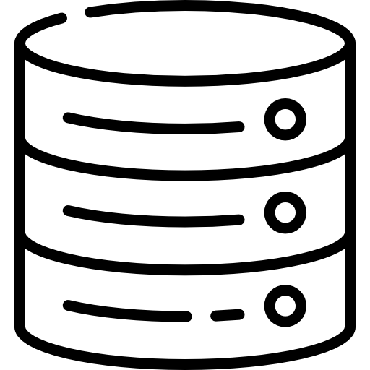
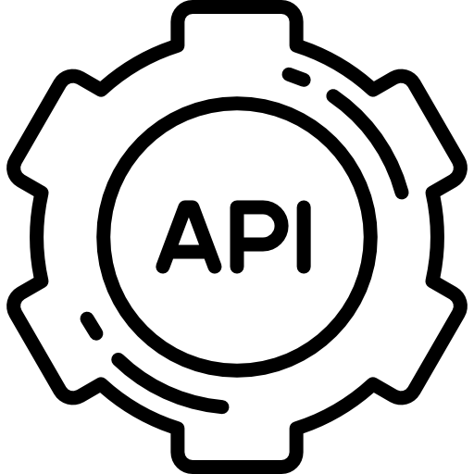
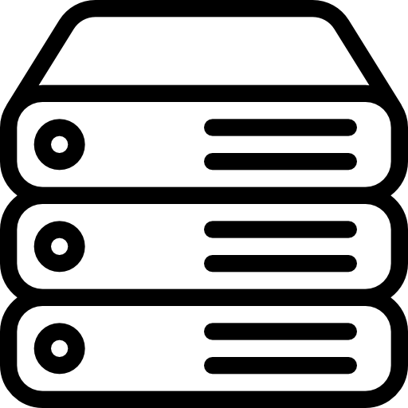



Website Data Transfer Type
Dinamis
Statis
4
2
5
3
3
1
1
2

Slide 12
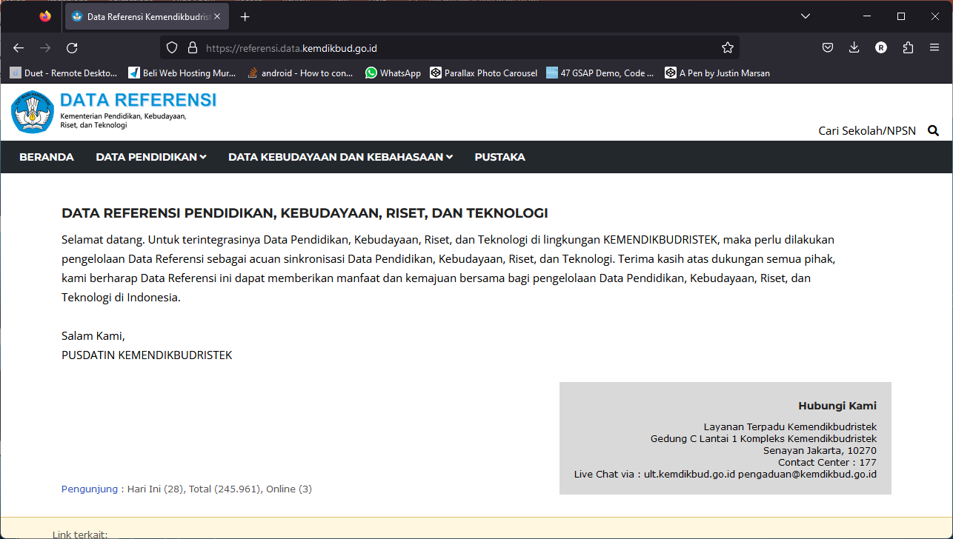
Referensi data kemendikbud

Slide 13
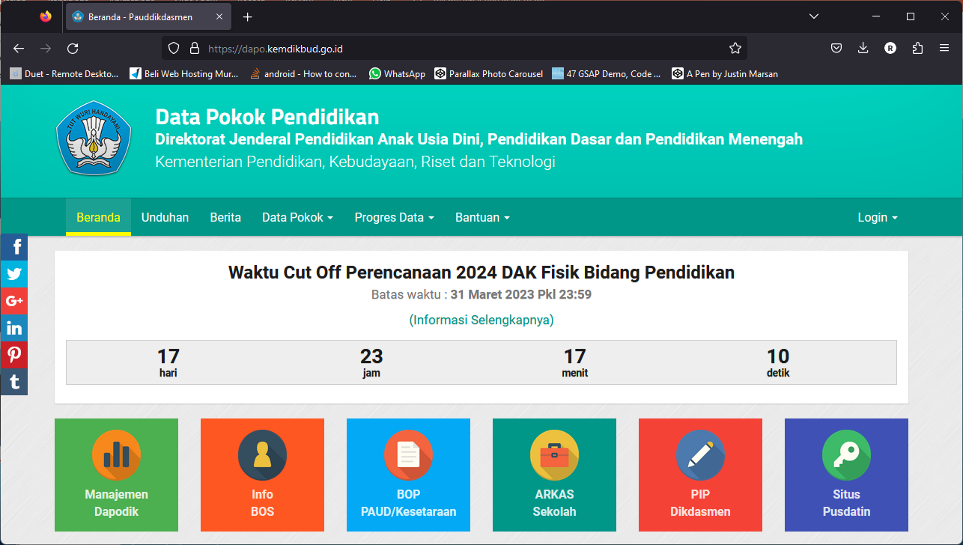
Data Pokok Pendidikan

Slide 14
Webscraper.io Demonstration & Hands-on

Slide 15
Demo: Scraping Congressional Press Releases
Representative Nancy Pelosi’s Press Releases
CONTENT
Structure of the Press Release subsection of the site
Pagination
Links to each release
Common elements of release
TOOLS
Webscraper.io tool works inside of Chrome
Tutorials
Documentation
Community
Free or, alternatively, Fee for Service

Slide 16
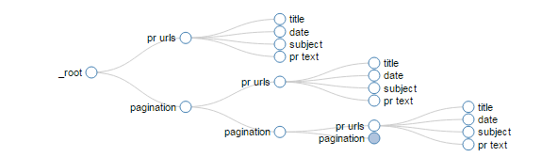

Slide 17
Now You Try It
http://v.gd/webscraping1111
Follow the download & installation instructions: step 9a
Find some congressional press release sites: step 9b
Follow the instructions: steps 1-8

